Slide 1
[ 이벤트 도출 ]
Ordered
OrderDeleted
Shipped
DeliveryCancelled
StockModified
ProductRegistered

Slide 2
[ 부적격 이벤트 도출 ]
메뉴 카테고리 선택됨
메뉴 검색됨
주문 상태 조회됨
고객 센터 고객 조회됨

Slide 3
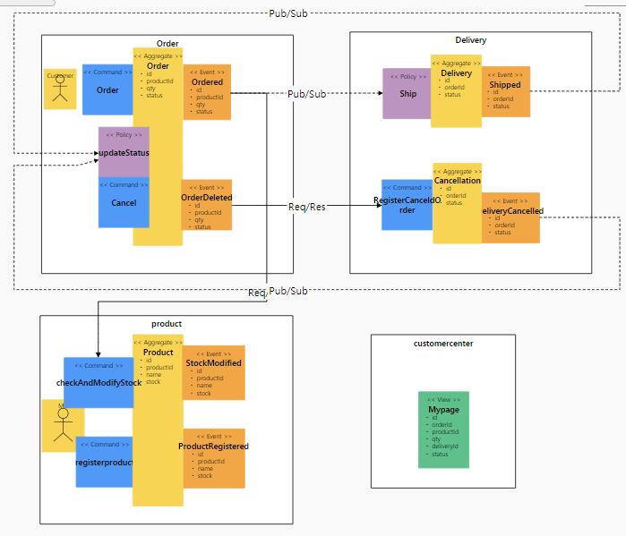
2
3
3
1

Slide 6
분산 이벤트 스트림 (Kafka)
Kafka
Publisher
Kafka
Listener
Kafka
Publisher
Kafka
Listener
Kafka
Publisher
Kafka
Listener
Apply
REST
Adaptor
Pay
REST
Adaptor
Delivery
MyPage
8081
8082
8083
8084
REST
Invoker
REST
Invoker
JPA
JPA
JPA
JPA
H2
H2
H2
HSQLDB
gateway
8080

Slide 7
분산 이벤트 스트림 (Kafka)
[Status]
ApplyCancelled : “payCancelled"
[Status]
payCompleted : “deliveryCompleted"
[Status]
Applied : “applyCompleted“
ApplyCancelled : “applyCancelled”
PayCompleted : “payCompleted“
PayCancelled : “payCancelled“
Deliveried : “deliveryCompleted“
DeliveryCancelled : “deliveryCancelled“
[Status]
Applied : “applyCompleted“
ApplyCancelled : “applyCancelled”
[Status]
PayCompleted : “payCompleted“
PayCancelled : “deliveryCompleted "
[Status]
Deliveried : “deliveryCompleted“
DeliveryCancelled : deliveryCancelled
Kafka
Publisher
Kafka
Listener
Kafka
Publisher
Kafka
Listener
Kafka
Publisher
Kafka
Listener
Apply
REST
Adaptor
Pay
REST
Adaptor
Delivery
MyPage
8081
8082
8083
8084
REST
Invoker
REST
Invoker
JPA
[Method]
post
JPA
[Method]
post
JPA
JPA
H2
H2
H2
HSQLDB
gateway
8080

